Slide 1

Working with Embeddings Part 3

Slide 2
San José State University Writing Center
“Using quotations is important in the writing process because they add strong evidence when used appropriately. However, embedding quotations effectively into sentences is just as important as finding the correct quotations to use. Correctly embedded quotations move the reader from the quoted text back into the paragraph smoothly.”
Notes:
https://www.sjsu.edu/writingcenter/docs/handouts/Embedding%20Quotations.pdf

Slide 3



Notes:
https://www.youtube.com/channel/UC35ZpwldGw7ZJ5R-2sLijzw

Slide 4


Membership has its privileges
Notes:
https://www.youtube.com/channel/UC35ZpwldGw7ZJ5R-2sLijzw/join

Slide 5
Embedding in Action
Putting Embedding to Use
Notes:
https://platform.openai.com/docs/api-reference/embeddings/create

Slide 6
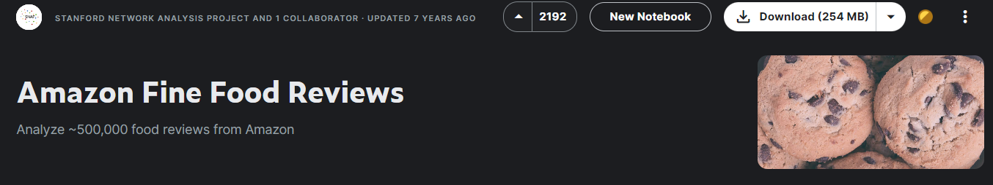
The Data: Amazon Food Reviews
Notes:
https://www.kaggle.com/datasets/snap/amazon-fine-food-reviews

Slide 7
Demo: Creating the Embeddings
def get_embedding(text, model="text-embedding-3-small"):
# Replace newlines
text = text.replace("\n", " ")
# Request the embedding
return client.embeddings.create(input=[text], model=model).data[0].embedding
Notes:
https://cookbook.openai.com/examples/get_embeddings_from_dataset

Slide 8
Demo: Loading Embeddings
df_load['embedding'] = df_load['embedding'].apply(eval).apply(np.array)

Slide 9
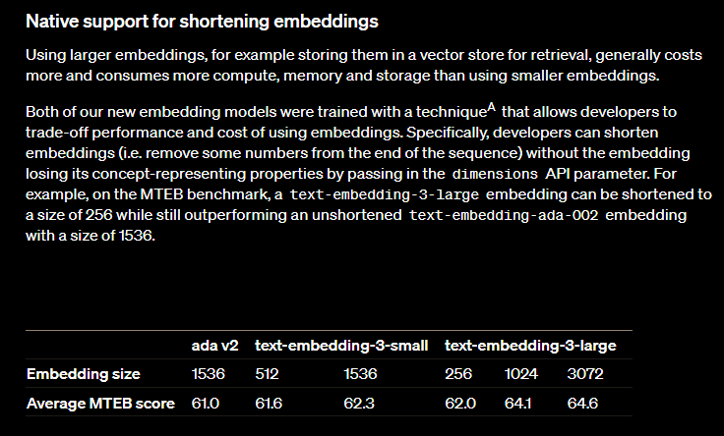
Reducing the Dimensions

Slide 10
Demo: Reducing the Dimensions
def get_embedding_reduced_dims(text,
model="text-embedding-3-large"):
# Replace newlines
text = text.replace("\n", " ")
# Request the embedding
return client.embeddings.create(input=[text],
model=model,dimensions=1024).data[0].embedding

Slide 11


